Slide 1
FINANCIAL Portfolio Optimization

Slide 2
Contents
Introduction
Problem Statement
Objectives
Methodology
Conclusion

Slide 3
Introduction
What is Portfolio?
It is a a range of investments held by a person or organization.
What is Portfolio Optimization?
Portfolio optimization is the process of selecting the best portfolio, out of the set of portfolios being considered, according to some objective.

Slide 4
Problem Statement
To find the optimum financial portfolio for a person or an organization

Slide 5
Objectives
To maximize factors such as expected return
minimize costs like financial risk.

Slide 6
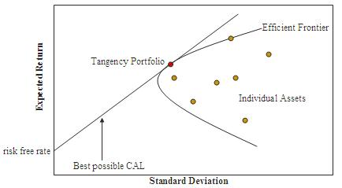
Methodology - Efficient Frontier Model
The efficient frontier (or portfolio frontier) is an investment portfolio which occupies the "efficient" parts of the risk–return spectrum.
The efficient frontier is the set of optimal portfolios that offer the highest expected return for a defined level of risk or the lowest risk for a given level of expected return.
Formally, it is the set of portfolios which satisfy the condition that no other portfolio exists with a higher expected return but with the same standard deviation of return (i.e., the risk).
The hyperbola is sometimes referred to as the "Markowitz bullet", and its upward sloped portion is the efficient frontier if no risk-free asset is available. With a risk-free asset, the straight capital allocation line is the efficient frontier.

Slide 7
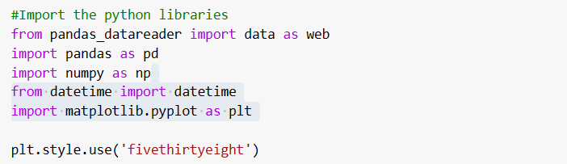
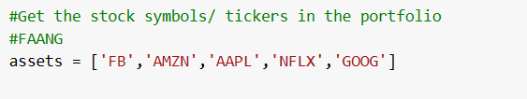


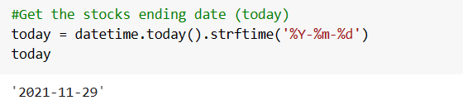
Implementation

Slide 8
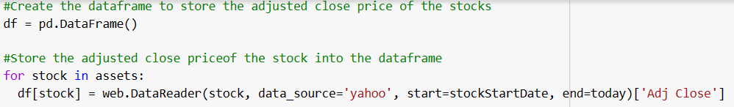
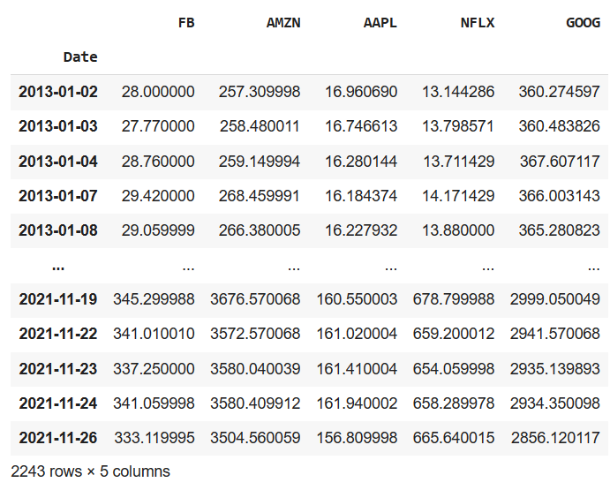
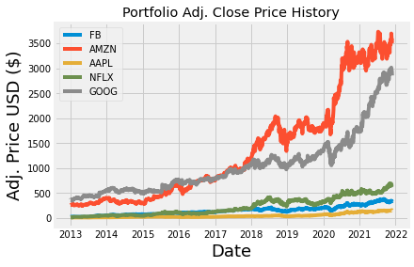
Implementation

Slide 9
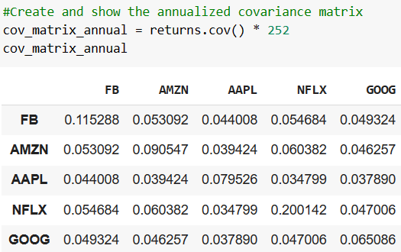
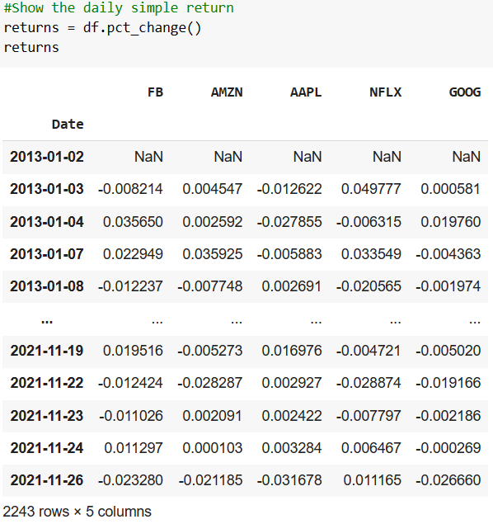
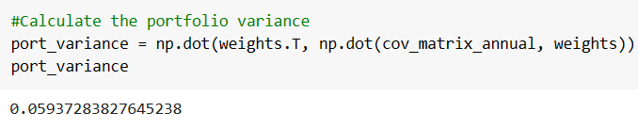
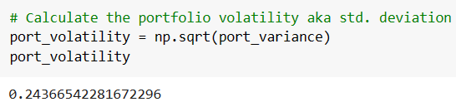
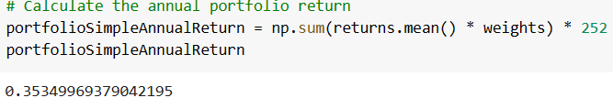
Implementation

Slide 10
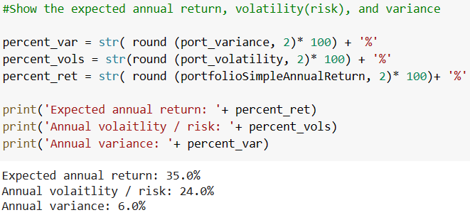
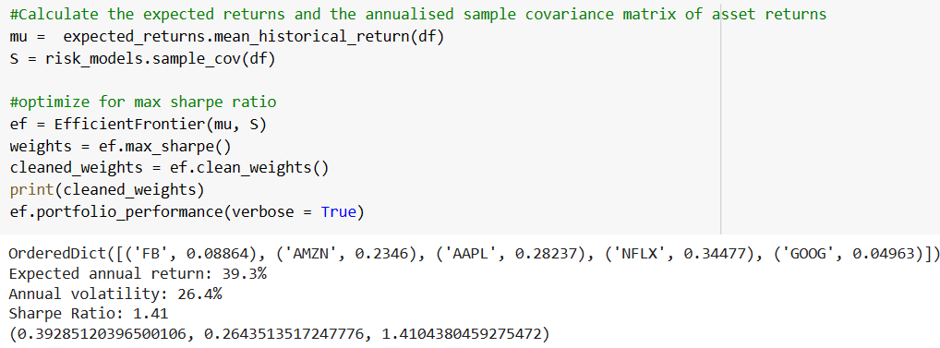
Implementation

Slide 11
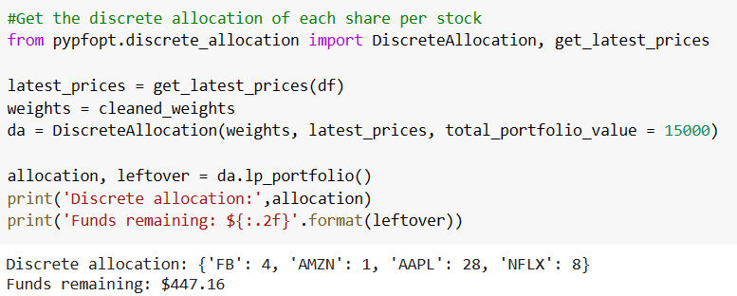
Output

Slide 12
Conclusion
If we invest amount of 15000$ for stocks, we can buy 4 shares of Facebook, 1 share of Amazon, 28 shares of Apple, 8 shares of Netflix optimally and can save $447.16

